Slide 1
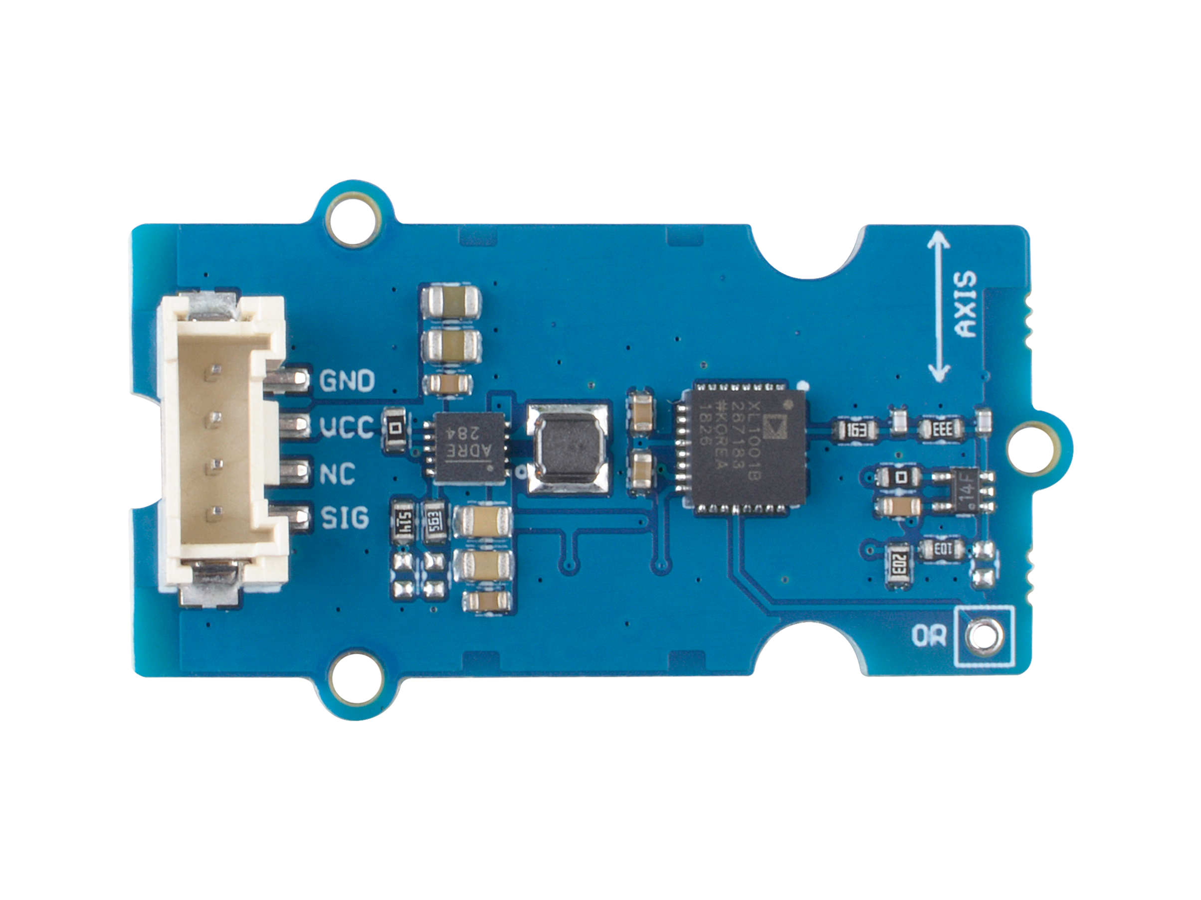




ADXL1001 Chip
Overrange Output
GND: connect this module to the system GND
VCC: you can use 5V or 3.3V for this module
NC: not connected
SIG: analog output voltage
Overrange Output
This pin instantaneously indicates when the overrange detection circuit identifies significant overrange activity.

Slide 2
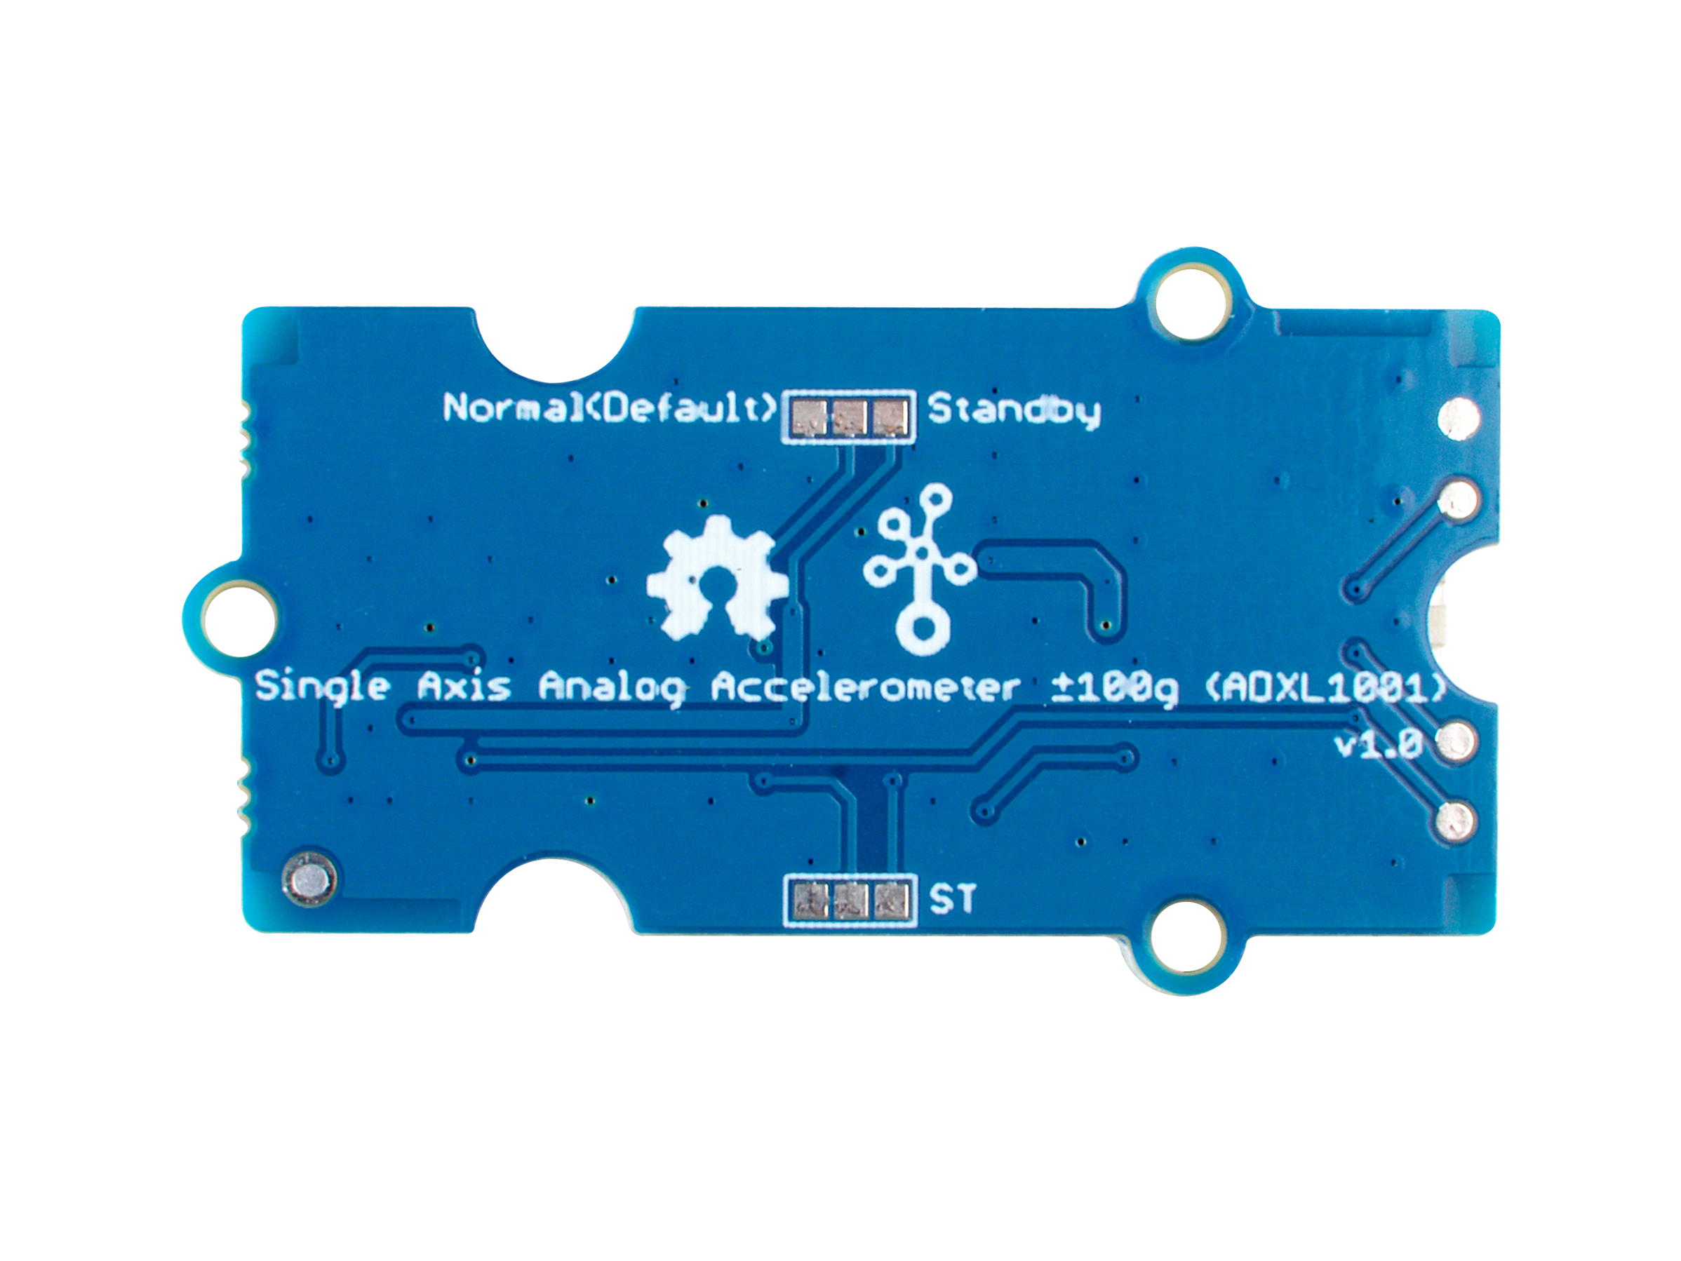
Mode select, default Normal
Self Test Input, Active High, default disable

